Slide 1




CSTU GPT Conversational Agent Final Project - CSE 646 AI Applications Prof - Laiq Ahmad
Sushil K Sharma, MS, MBA
www.LinkedIn.com/in/krishnatray
https://github.com/krishnatray/cstu_ai_app_cse646

Slide 2
Outline
Opportunity Analysis
Capability Mapping
Technical Design / Architecture
Process
Demo
Conclusion

Slide 3
Opportunity
CSTUGPT is smart and friendly conversational assistant designed to improve student engagement, streamline administrative tasks, and provide personalized information. From answering FAQs to offering real-time updates, course registration, and academic advising, the Chatbot enhances the university experience with convenient, efficient, and personalized support.”

Slide 4
Capability Mapping
Prospects
Know more about CSTU
Academic programs offered at CSTU
Application Requirements for a Program
Students
List Course Offerings
Course Registration
Registration Confirmation / Reconfirmation
Check Grades
Download Transcript
Professors /Staff Members/Admin
Upload Grades
Course Registration Summary Reports

Slide 5






TECHNICAL ARCHITECTURE
Backend (Python)
Prospect/
Student,
Web UI
Embeddings
OpenAI API
Professor/
Admin
Vector Database
Database
Notes:
Sushil: to present
Describe the underlying technology stack, including the use of LLM and other related technology.
b) Outline the system architecture and its components, highlighting any innovative or unique features.

Slide 6
System Architecture
High-level diagram of the system architecture
Key Components:
+ Frontend: Streamlit as a user interface for the chatbot
+ Backend: Python application and OpenAI GPT
+ Knowledge Base: Pinecone as a repository of information
Notes:
?? Presenting seems like we covered already in the diagram slide 4. Suggest we remove this slide. “Hiding” slide for now. (Phil)

Slide 7

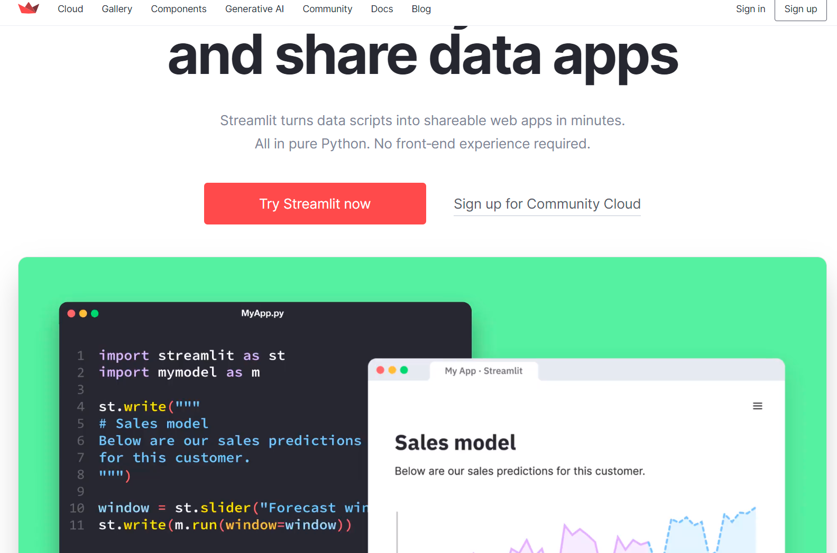
Underlying Technology - Streamlit
Faster Way to build and Share Data Apps
Comes as Python Library
pip install streamlit
Integration with github
Quickly deploy app at streamlit.io
Comes with lots of components e.g. chat
Works well with python libraries e.g. pandas
Notes:
Sushil: to present

Slide 8
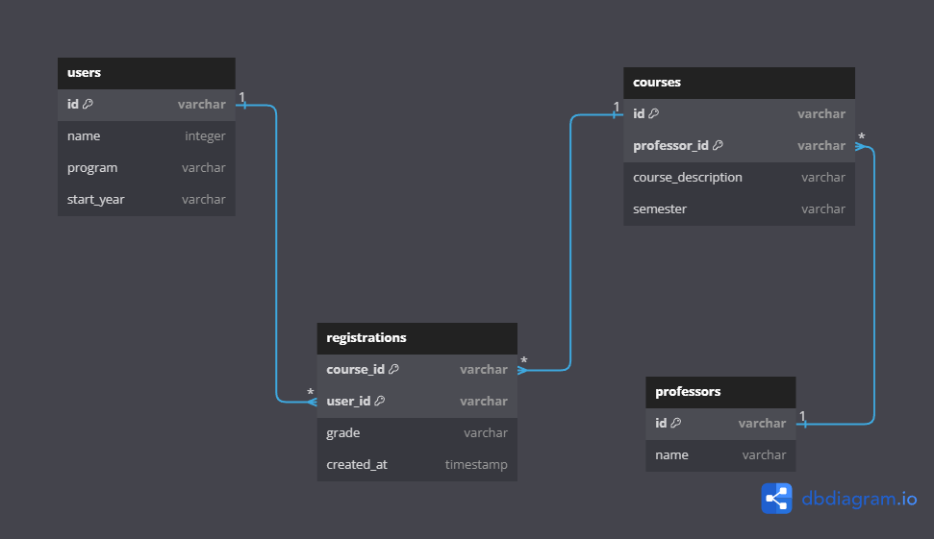
DATABASE DESIGN
Notes:
Sushil: to present

Slide 9
Underlying Technology
1) Large Language Model (LLM):
Model Details: OpenAI gpt-3.5-turbo-0613 & text-embedding-ada-002
Core Functionality:
User Interaction
Language Understanding
Generating Responses including function call
Conversational Flow
Personalization
This model serves as the central intelligence in chatBots, enabling dynamic and personalized interaction with users.
Notes:
Fang: to present
LLM serves as the core intelligence behind the ChatBot's ability to understand natural language inputs, generate contextually relevant responses, maintain conversational context, and even generate content for emails. It empowers (enhance the conversation capabilities and responses of) the ChatBot to provide a more human-like and engaging conversational experience for users. Here's how LLM is utilized:
User Interaction: When a user interacts with the ChatBot through the Streamlit app by entering questions or messages, these inputs are sent to the OpenAI API for processing.
Language Understanding: The OpenAI GPT-3.5 model, which is an LLM, is trained on a massive amount of text data and can understand and interpret natural language inputs effectively. It understands the context, semantics, and nuances of the user's messages.
Generating Responses: The primary function of the LLM is to generate responses based on the user inputs. It generates text that is contextually relevant and aims to provide meaningful answers, explanations, or information based on the queries it receives.
Conversational Flow: The LLM helps maintain the conversational flow by understanding previous messages in the chat history and crafting responses that fit within the ongoing conversation. This enables the ChatBot to provide coherent and contextually appropriate responses.
Personalization: The LLM can use the information provided by the user, such as their name or other context, to generate personalized responses. This creates a more engaging and user-centric interaction.
Generating Email Content: The LLM is also used to generate content for emails, such as registration confirmation messages. It can craft well-structured and relevant content to send to users' email addresses.
Temperature Parameter: The project code includes a "temperature" parameter when calling the LLM, which determines the randomness of the generated responses. A higher temperature value increases randomness, while a lower value makes the responses more deterministic and focused.

Slide 10
Underlying Technology
2) OpenAI API
Serving as the backbone of the ChatBot, enabling the generation of responses and embeddings:
Generating responses:
- Conversation history
- Parameters
Function call: registration function for recording user information and sending a confirmation email
Generating embeddings: text-embedding-ada-002 model
Notes:
Fang: to present
The OpenAI API serves as the backbone of the ChatBot’s, plays a crucial role by enabling the generation of responses and embeddings, which are essential for creating meaningful and interactive conversations. It enables the ChatBot to understand user queries, generate coherent responses, and create meaningful embeddings for efficient information retrieval to provide human-like interactions and enhance the overall user experience.
Here's how the OpenAI API is used for these purposes:
Generating Responses: The OpenAI API is utilized to generate responses to the ChatBot. When a user inputs a message or query, it's sent to the OpenAI API for processing. The API employs advanced language models, such as GPT-3, to analyze the input and generate relevant and contextually appropriate responses. These responses can be in the form of textual messages that the ChatBot can provide to users, mimicking natural language conversations. The API offers control over the response generation process through parameters like "temperature" and "max tokens." Temperature controls the randomness of the generated responses, allowing the ChatBot to produce more diverse and creative outputs. Max tokens restricts the length of the generated response to a specified number of tokens, preventing excessively lengthy replies.
Generating Embeddings: Embeddings are numerical representations of text that capture its semantic meaning. Embeddings play a critical role in various natural language processing tasks, including information retrieval and similarity analysis. In the ChatBot project, embeddings are used to represent the content of documents and user queries. The OpenAI API provides an "Embedding" endpoint that allows developers to create embeddings for input text. These embeddings are compact numerical vectors that encode the underlying meaning of the text. Embeddings are useful for various tasks, including comparing the similarity between documents, clustering similar documents, and enhancing the retrieval of relevant information from a knowledge base.

Slide 11
Underlying Technology
3) Pinecone – A knowledge base for chatbot
Creating index and storing numerical vectors generated from document chunks by OpenAI embedding model into knowledge base.
Enriching knowledge base: Pinecone's indexing capabilities enable us to continuously enrich its knowledge base by adding new vector data.
Performing a comparison and similarity search in the knowledge base for generated embedding of user input.
Retrieving most relevant information by extracting the corresponding metadata from these vectors, including the content of the knowledge base entries.
Notes:
Lam: to present
Pinecone plays a vital role in the ChatBot project by enabling efficient vector storage, indexing, search and retrieval, which is essential for providing accurate and contextually relevant response information to users.
Creating index and storing numerical vectors generated from document chunks by OpenAI embedding model into knowledge base: In the ChatBot project, embeddings of textual data, such as user queries and knowledge base content, are used as vectors. These embeddings capture the semantic meaning of the text and are used to represent the content in a high-dimensional space. Numerical vectors (data points) are organized and indexed in Pinecone database (knowledge base). Pinecone index is a data structure optimized for efficient (fast and accurate) similarity search and retrieval.
Knowledge Base Enrichment: Pinecone's indexing capabilities also enable the ChatBot to continuously enrich its knowledge base. New documents or pieces of information can be added to the index as new vectors. This means that as the ChatBot interacts with users and learns from their queries, it can incorporate new knowledge and adapt its responses over time
Performing a comparison and similarity search in the knowledge base for generated embedding of user input: When a user inputs a query, the ChatBot generates an embedding for the query text using the OpenAI embedding model. This embedding represents the user's intent or question. The ChatBot then utilizes Pinecone's indexing capabilities to perform a similarity search to identify the similar information.
Retrieving most relevant information by extracting the corresponding metadata from these vectors, including the content of the knowledge base entries .

Slide 12
Workflow
User Input: could be a question, a query, or a request for information.
API Call to OpenAI for Embedding: generating an embedding for the user's input
Embedding Comparison with Knowledge Base: performing a similarity search for generated embedding of user input in the knowledge base
Retrieval of Relevant Information: extracts the corresponding information (metadata) from these vectors, including the content of the knowledge base entries
Response Generation: Generating a response to the user's query based on the retrieved relevant information, initial system guide and context history.
Display Response: Displaying answers to the user through the web user interface
Notes:
Joyce: to present
User Input: The interaction begins when a user provides an input to the ChatBot. This input could be a question, a query, or a request for information. The user submits their input through the user interface of the ChatBot application.
API Call to OpenAI for Embedding: Once the user input is received, the ChatBot makes an API call to the OpenAI API to generate an embedding for the user's input. The embedding captures the semantic meaning of the text and represents it as a numerical vector.
Embedding Comparison with Knowledge Base: The ChatBot takes the generated embedding for the user input and performs a similarity search in the knowledge base. It uses Pinecone's indexing capabilities to retrieve vectors from the knowledge base that are most similar to the user's query embedding. These retrieved vectors correspond to knowledge base entries that are contextually relevant to the user's query.
Retrieval of Relevant Information: Pinecone returns a list of vectors representing knowledge base entries that are contextually relevant to the user's query. The ChatBot extracts the corresponding information from these vectors, which typically include the content of the knowledge base entries.
Response Generation: Based on the retrieved relevant information, the ChatBot generates a response to the user's query. It may use the content from the knowledge base vectors as part of the response or craft a response based on a combination of the knowledge base content and other predefined responses.
Display Response: The generated response is then displayed to the user through the user interface of the ChatBot application. The user sees the response on their screen, allowing them to understand and engage with the information provided by the ChatBot.
User Interaction Continues: The user may continue the interaction by providing additional input or queries. The ChatBot repeats the process of generating embeddings, performing similarity searches, and generating responses for each new user input.
Throughout this workflow, the integration of OpenAI and Pinecone plays a crucial role. OpenAI's API generates embeddings that capture the meaning of user input, allowing the ChatBot to understand the user's intent. Pinecone's indexing capabilities ensure efficient and accurate retrieval of relevant information from the knowledge base, enhancing the ChatBot's ability to provide contextually relevant responses.

Slide 13
DEMO

Slide 14
Thanks

